Slide 1
GPU Computing
Dr. Amit Barve

Slide 2
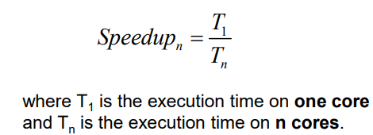
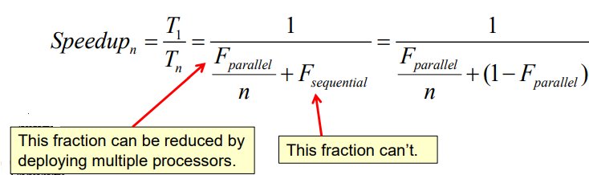
Amdahl's law

Slide 3
Parallel Programming Workflow
Take correct serial code with sample input testcases (small, medium, large) and example outputs (for verification)
Profile the code
Select the most time consuming routine / code
Parallelize this routine
Repeat steps 2,3,4 until all (most) of the routines are parallelized

Slide 4
Sample input testcases and output verification
●
Input Testcases
– Small : smaller testcase for development and testing, should not take more than few minutes
Medium : Typical problem size you use regularly
Large : Problem size you really want to target once you have parallel version of the code
–
–
Output verification
– Floating point numbers will not match exactly. Not even serial codes compiled with different compilers on same processor or different processor architecture!
●
– We should define method for error/difference calculation and acceptable error/ difference tolerance.
Number of testcses : varies; but should cover all the different parts of the codes – boundary conditions, different cell types etc
●

Slide 5
How it differs from CPU?

Slide 6
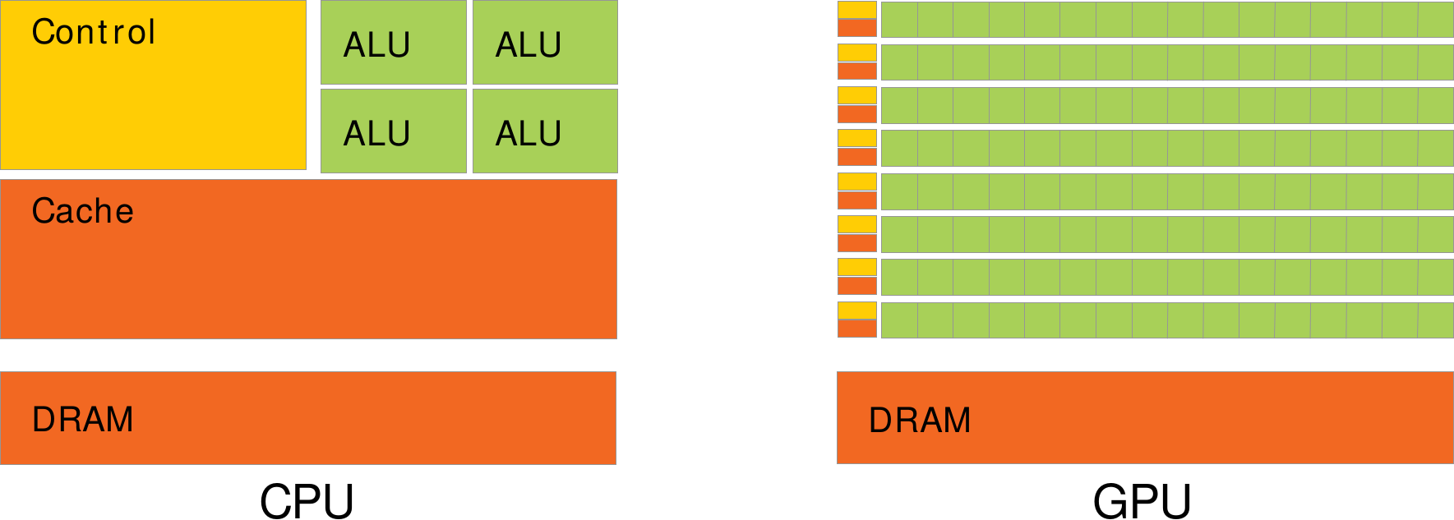
CPU vs GPU
Source: CUDA C Programming Guide (NVIDIA)

Slide 7
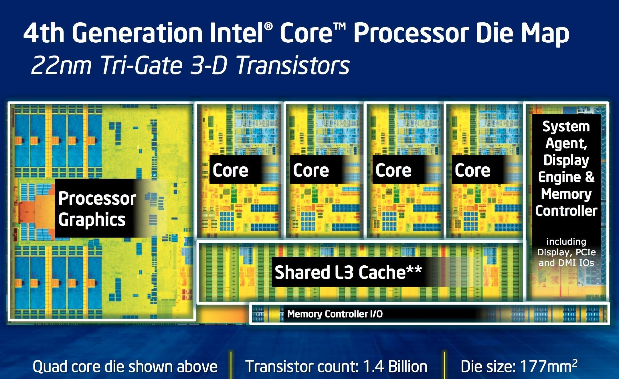
http://images.anandtech.com/doci/7003/Screen%20Shot%202013-05-31%20at%207.59.16%20PM.png

Slide 8
CPU vs GPU
●
CPU
●
GPU
– Optimized for serial thread
performance
Good for complex tasks
Few, large, complex cores
Large number of transistors are allocated for Caches, Instruction Level Parallelism
– Optimized for data parallel,
throughput computations
Large number of very small, simple cores
More number of transistors are allocated for computations
–
–
–
–
–

Slide 9
Nvidia GPU microarchitecures

Slide 10
Nvidia microarchitectures
Tesla Fermi Kepler Maxwell Pascal Volta Turing
●
●
●
●
●
●
●

Slide 11
Streaming Multiprocessor(SM)
Basic building block Contains
Multiple CUDA cores
Special Function Units (SFUs): The Special Function Unit (SFU) is an accelerator devoted to perform tracendental and trigonometric operations.
Register file : a critical structure that maintains the state for thousands of threads that support the GPU processing model.
L1 cache / Shared memory
– Tex : a texture processing unit (TPU), is a hardware component that does sampling. Sampling is the process of computing a color from an image texture and texture coordinates.

Slide 12
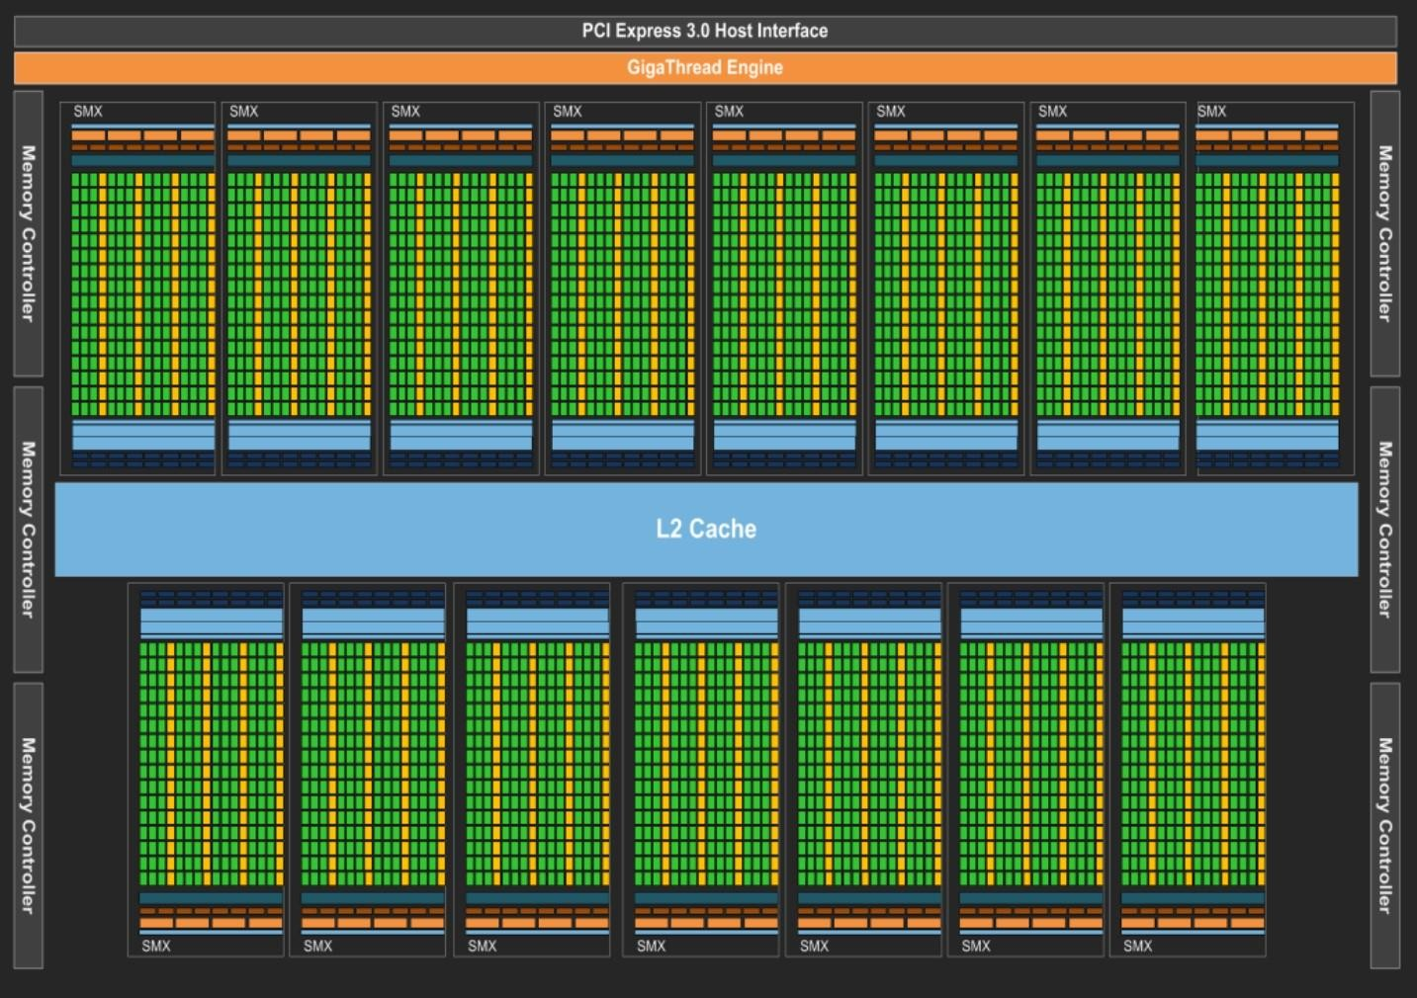
Kepler GPU

Slide 13
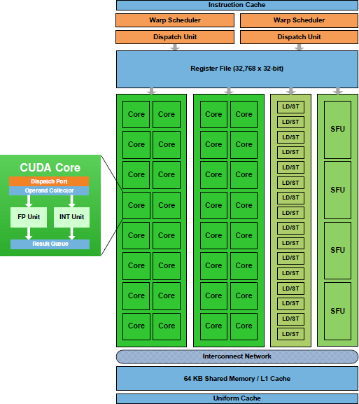
Fermi

Slide 14
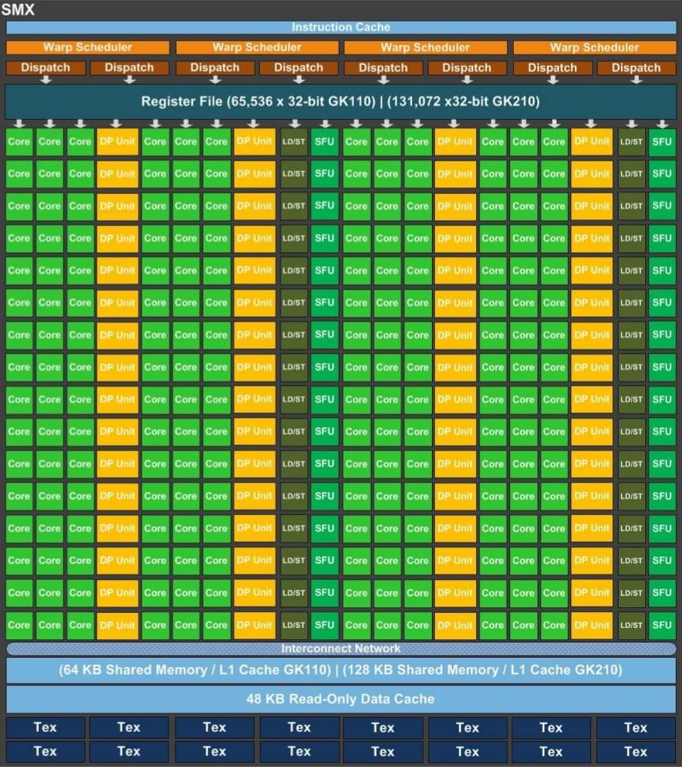
Kepler
●
192 single-precision
CUDA cores
64 double-precision units
32 special function units
32 load/store units
4 warp schedulers
8 instruction dispatch units
48 KB Read-Only
Data Cache
64/128 KB L1 cache
/ shared memory
●
●
●
●
●
●
●

Slide 15
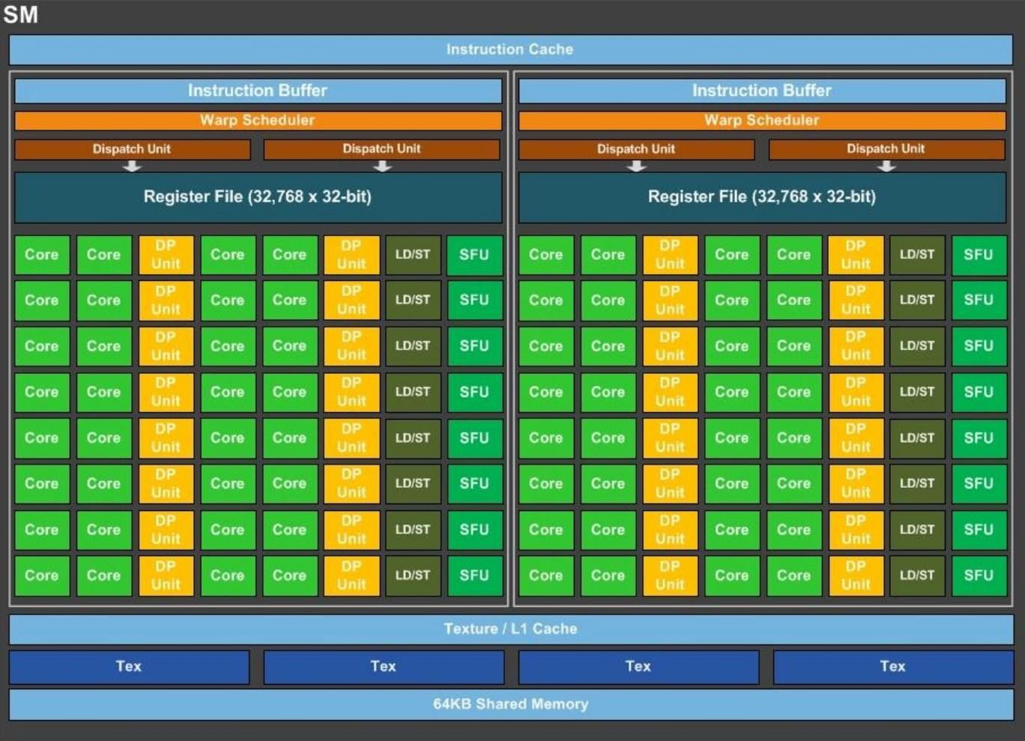
Pascal

Slide 16
Pascal (contd)
two processing blocks, each with
32 single-precision CUDA Cores
16 double precision (FP64) CUDA Cores
one instruction buffer
one warp scheduler
two dispatch units
●

Slide 17
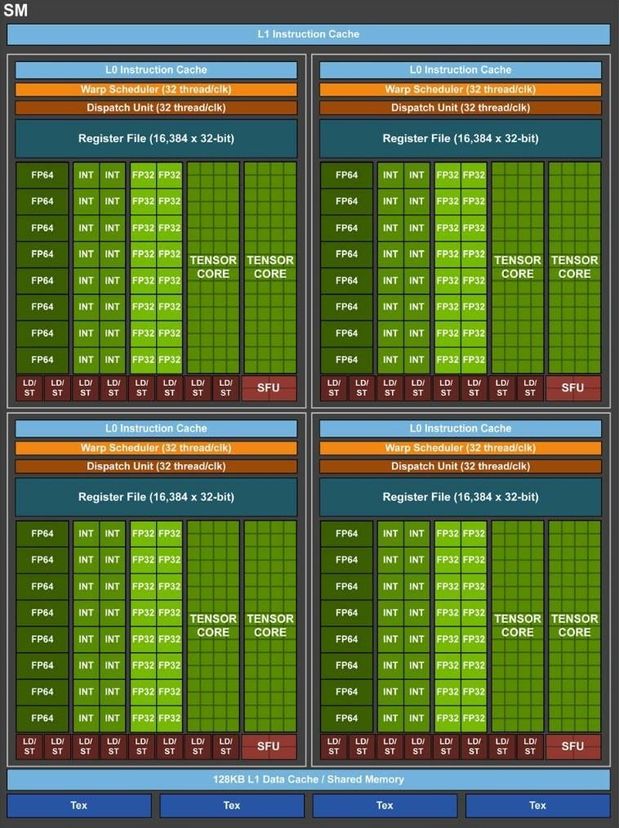
Volta
Four processing blocks

Slide 18
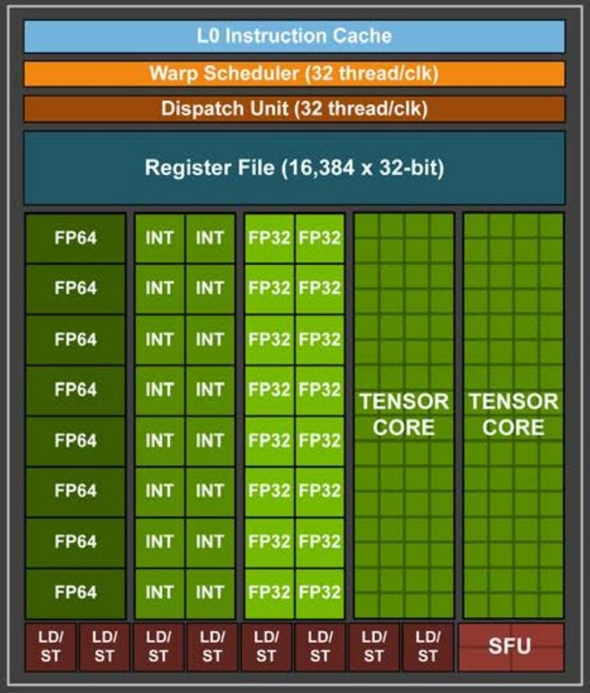
Volta(contd)
each processing block has
16 FP32 Cores
8 FP64 Cores 16 INT32 Cores
2 new mixed-precision Tensor Cores
one L0 instruction
cache
one warp scheduler one dispatch unit
64 KB Register File
●
●
●
●
●
●

Slide 19
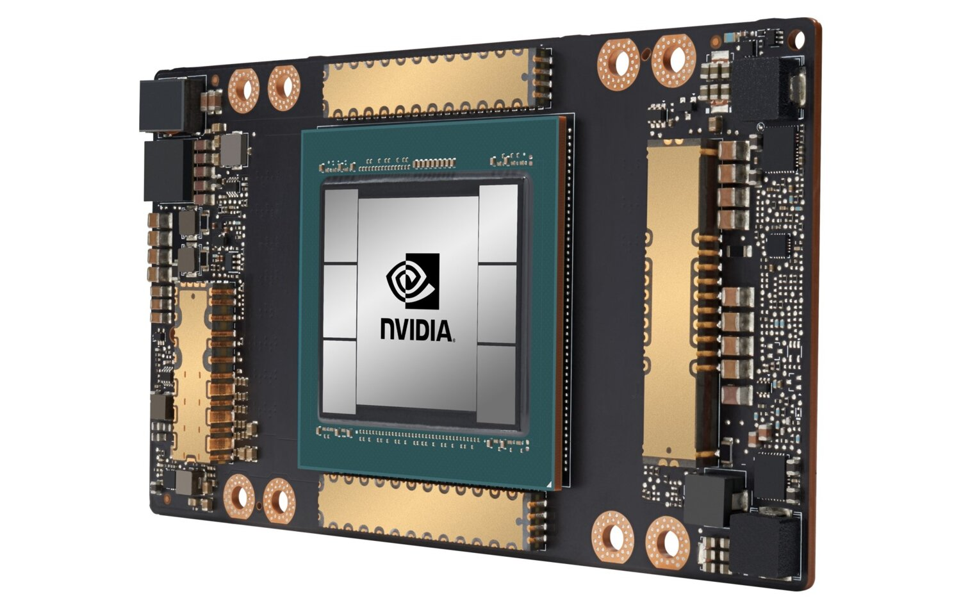
NVIDIA Ampere A100

Slide 20
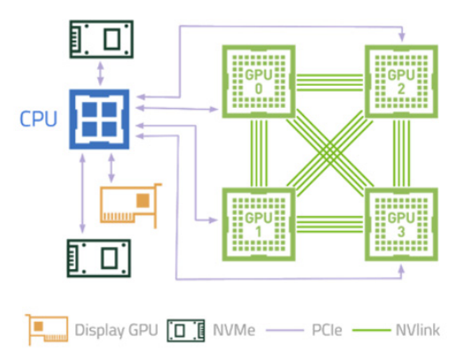
DGX Station A100 devices topology

Slide 21


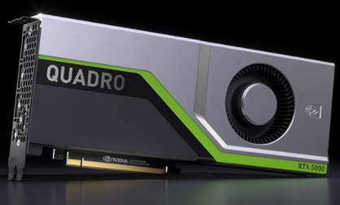
NVIDIA QUADRO RTX 5000
NVIDIA® Quadro RTX™ 5000. Powered by the NVIDIA Turing™ architecture and the NVIDIA RTX™ platform, it fuses ray tracing, deep learning to supercharge next-generation workflows.

Slide 22
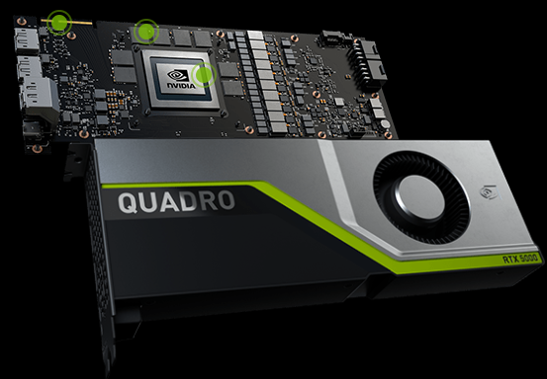
NVIDIA QUADRO RTX 5000

Slide 23
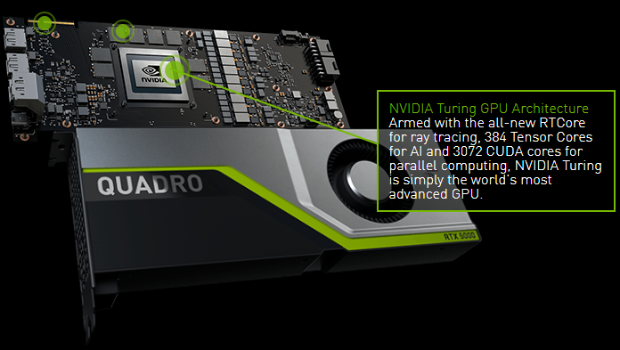
NVIDIA QUADRO RTX 5000

Slide 24
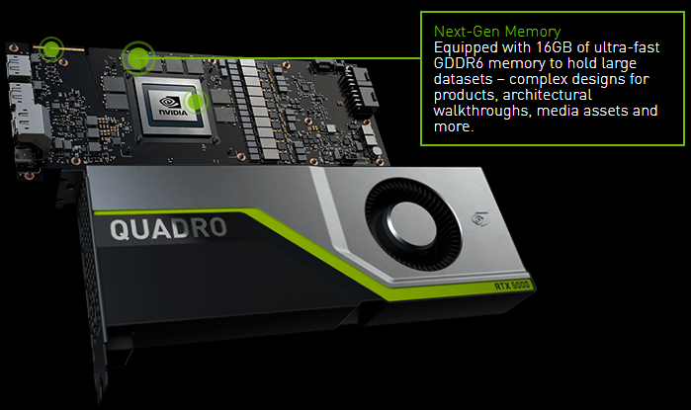
NVIDIA QUADRO RTX 5000

Slide 25
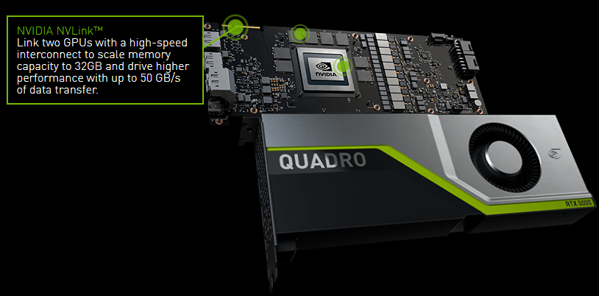
NVIDIA QUADRO RTX 5000

Slide 26
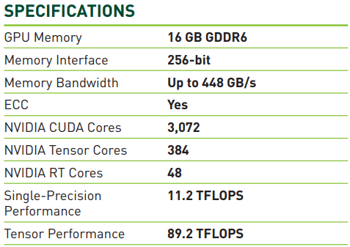
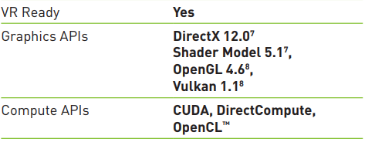
NVIDIA QUADRO RTX 5000

Slide 27
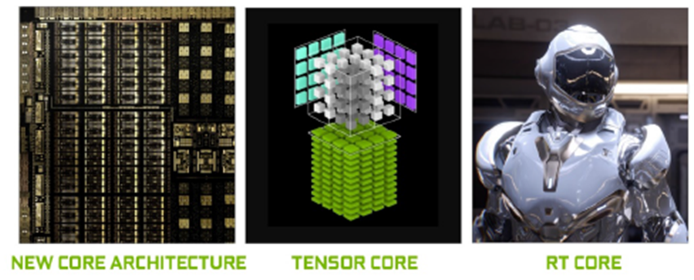
NVIDIA QUADRO RTX 5000

Slide 28
Turing Architecture- New Core Architecture
Turing represents the biggest architectural leap forward in over a decade, providing a new core GPU architecture that enables major advances in efficiency and performance for PC gaming, professional graphics applications, and deep learning inferencing.
Using new hardware-based accelerators and a Hybrid Rendering approach, Turing fuses rasterization, real-time ray tracing, AI, and simulation to enable incredible realism in PC games, amazing new effects powered by neural networks, cinematic-quality interactive experiences, and fluid interactivity when creating or navigating complex 3D models.

Slide 29

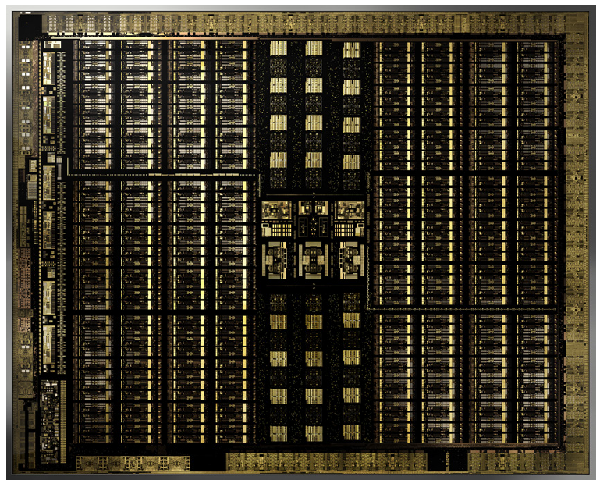
NVIDIA Turing Architecture

Slide 30
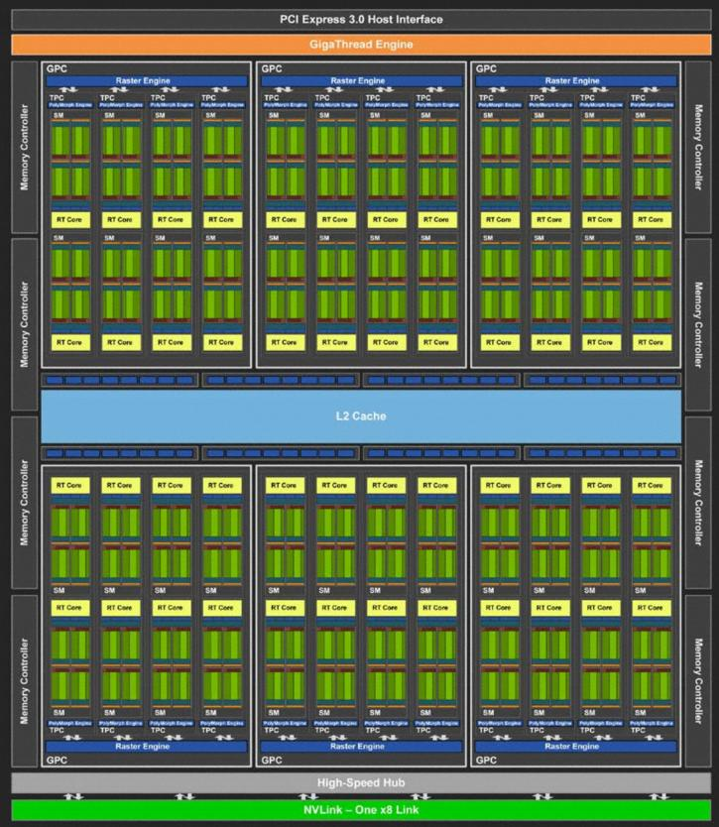
NVIDIA Turing Architecture

Slide 31
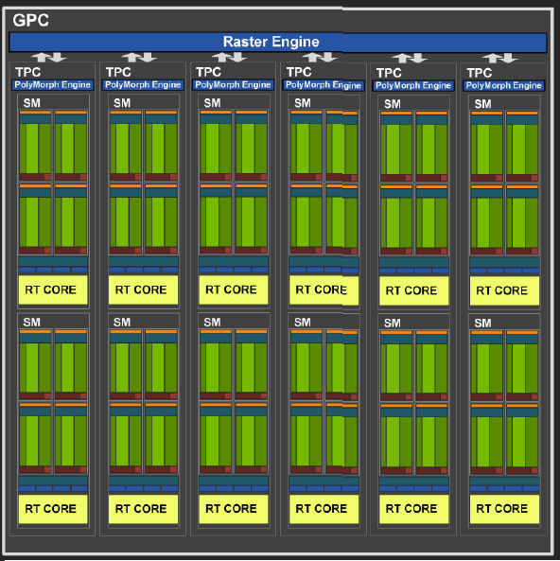
NVIDIA Turing Architecture

Slide 32
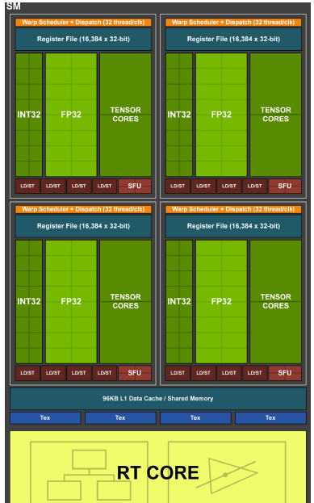
NVIDIA Turing Architecture

Slide 33
Tensor Cores
Tensor Cores are specialized execution units designed specifically for performing the tensor / matrix operations that are the core compute function used in Deep Learning.
The Turing Tensor Cores provide tremendous speed-ups for matrix computations at the heart of deep learning neural network training and inferencing operations.

Slide 34
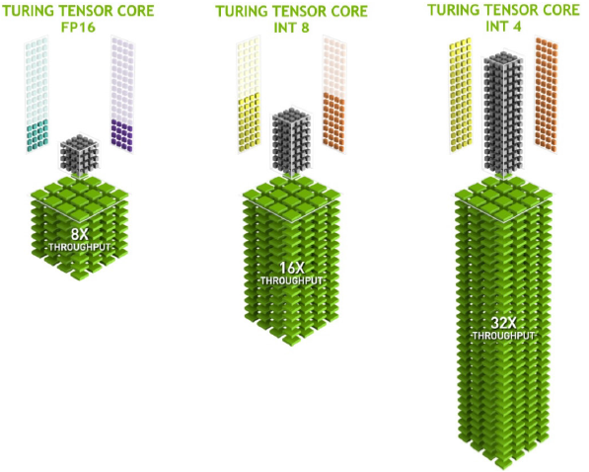
Tensor Cores

Slide 35
DEEP LEARNING SUPER-SAMPLING (DLSS)
DLSS leverages a deep neural network to extract multidimensional features of the rendered scene and intelligently combine details from multiple frames to construct a high-quality final image.

Slide 36
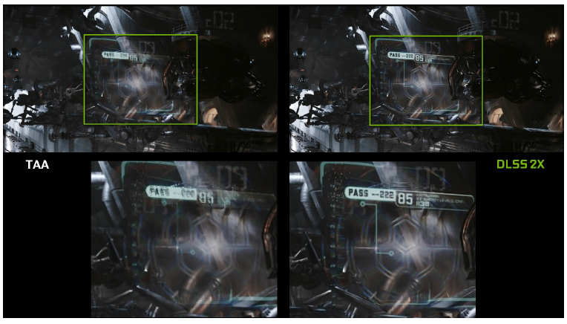
DLSS

Slide 37

AI Super Rez
AI Super Rez Provides Improved Image Clarity Over Other Filtering Methods

Slide 38
INPAINTING
InPainting allows an application to provide features to remove existing content from an image and use an NGX AI algorithm to replace the removed content with a realistic computer-generated alternative.

Slide 39
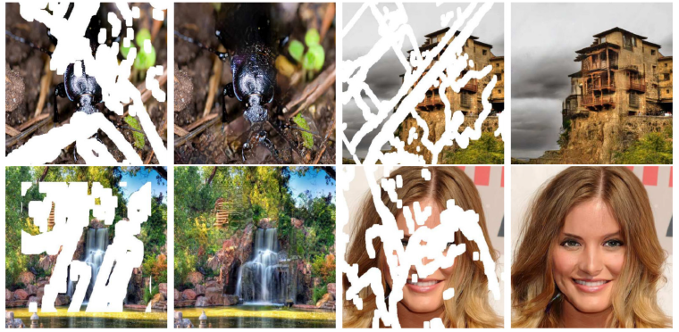
INPAINTING
InPainting Examples, Missing Image Data Is Intelligently Replaced with Meaningful Image Information
https://www.youtube.com/watch?v=gg0F5JjKmhA

Slide 40
Super Slow Motion
Demo
https://www.youtube.com/watch?v=MjViy6kyiqs

Slide 41
Ray Tracing
Ray tracing is a computationally-intensive rendering technology that realistically simulates the lighting of a scene and its objects. Turing GPU-based ray tracing technology can render physically correct reflections, refractions, shadows, and indirect lighting in real-time.

Slide 42
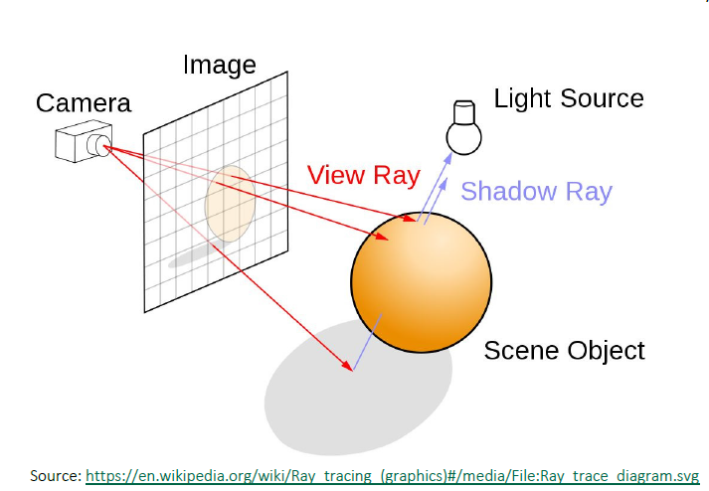
RAY Trace

Slide 43
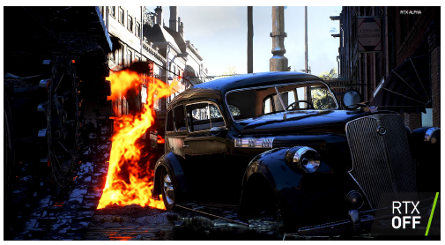
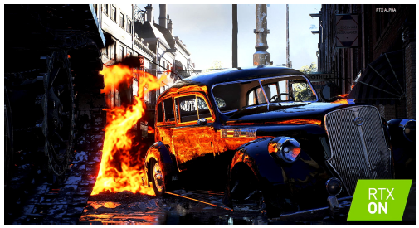
RTX Example
Scenes from the Alpha Version of the Battlefield V game from publisher Electronic Arts and developer EA. Dice is using NVIDIA RTX Technology and Turing real-time ray tracing for multiple effects in the game. You can see realistic reflections on the car from an off-screen explosion in the RTX ON scene. Such reflections are not possible with screen-space reflections without ray tracing, as in the RTX OFF scene.

Slide 44


RTX Example
Scenes from a pre-release version of Shadow of the Tomb Raider with RTX ON vs OFF. With RTX OFF, there are no shadows cast from the sparklers being held by the children, so they look like they are floating above the surface. With RTX ON, the shadows are correct.
https://www.youtube.com/watch?v=KJRZTkttgLw

Slide 45

PARAM SHAVAK SUPERCOMPUTER @ Parul University

Slide 46

Configuration
2 - Intel® Xeon® Gold 6145 Processor (40 cores)
1 – NVIDIA QUADRO RTX 5000
96 GB RAM
16 TB HDD

Slide 47
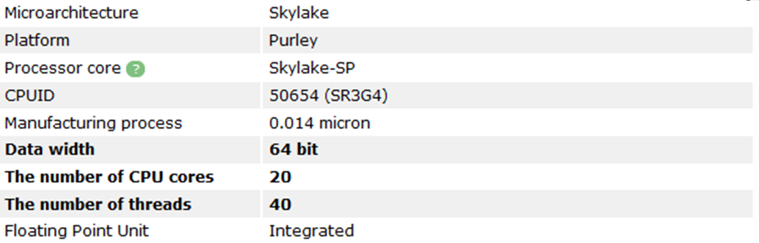
CPU Specification

Slide 48
Performance Considerations for
GPGPU computing

Slide 49
Performance
Considerations
PCIe transfers SIMT model Latency hiding
●
●
●

Slide 50
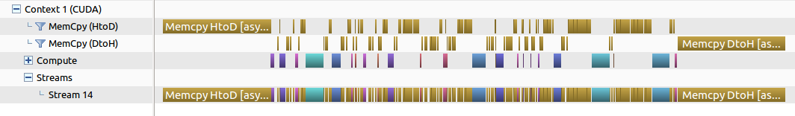
Execution time = time for Computations + time for data transfers
Slow* PCIe transfers degrade performance PCIe 3.0 : 32 GBps Bi-directional
PCIe transfers
●
●
●
●
GPU may have only one copy engine!

Slide 51
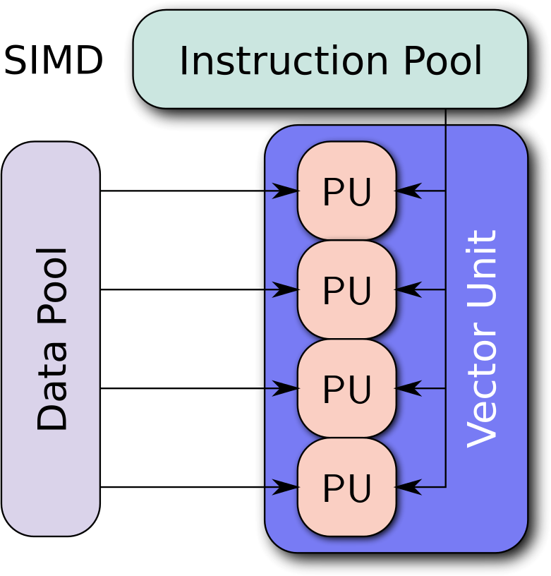
SIMT model
●
Single Instruction, Multiple Threads
https://en.wikipedia.org/wiki/SIMD#/media/File:SIMD2.svg (CC BY-SA 4.0)

Slide 52
SIMT model issues
if (some_condition)
{
. . .
. . .
}
else
{
. . .
. . .
}

Slide 53
SIMT model issues
if (some_condition)
{
. . .
. . .
}
else
{
. . .
. . .
}

Slide 54
SIMT Model issues
for (“n” number of threads)
{
for (“m” iterations)
{
}
}
What if “m” is not same for all the “n” threads?

Slide 55
SIMT Model issues
for (“n” number of threads)
{
for (“m” iterations)
{
}
}
What if “m” is not same for all the “n” threads?

Slide 56
Latency Hiding
CPUs are optimized for Single thread performance where as GPUs use large number of threads to amortize cost of time consuming operations (such as memory access etc.)
●
No of threads for parallel application
CPU : should be <= number of cores
GPU : should be >> number of cores
●

Slide 57
How to program these GPUs for general purpose computing?

Slide 58
Pseudo Code (old method)
Allocate and initialize memory on Host (CPU)
Allocate memory on Device (GPU)
Transfer data from Host memory to Device memory
Launch “kernel” on the Device – large number of threads execute in parallel on Device
Transfer results from Device memory to Host memory
De-allocate all the memory and terminate the program

Slide 59
Pseudo Code (new method)
Allocate and initialize Host Memory
Launch “kernel” on the Device – large number of threads execute in parallel on Device (Magic Step!)
De-allocate all the memory and terminate the program

Slide 60
Introduction to CUDA

Slide 61
CUDA
●
Parallel computing platform and application programming interface (API)
Nvidia Corp.- General Purpose Graphics Processing Unit (GPGPU)
Supports most of the today's Nvidia's gaming cards. Platforms
●
●
●
–
–
–
–
Geforce : Desktop Quadro : Workstation Tesla : Datacenter
Tegra, Jetson, Drive : Embeded

Slide 62
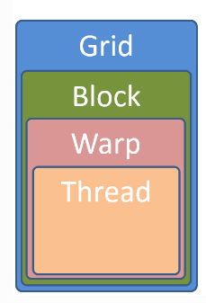
CUDA execution Units

Slide 63
Grids
A kernel is executed as a grid of blocks
Other words, CUDA blocks are grouped into a grid
Each CUDA block is executed by one streaming multiprocessor (SM) and cannot be migrated to other SMs in GPU

Slide 64
Block
A group of threads is called a CUDA block.
Each CUDA block is executed by one streaming multiprocessor (SM)

Slide 65
Warps
A warp is a set of 32 threads within a thread block such that all the threads in a warp execute the same instruction.
The Fermi architecture can simultaneously handle 48 warps per SM for a total of 1536 threads in a single SM at a time. Within the SM, 32 cores are divided into two execution blocks of 16 cores each

Slide 66
Thread
A thread on the GPU is a basic element of the data to be processed. Unlike CPU threads, CUDA threads are extremely “lightweight,” meaning that a context change between two threads is not a costly operation.

Slide 67
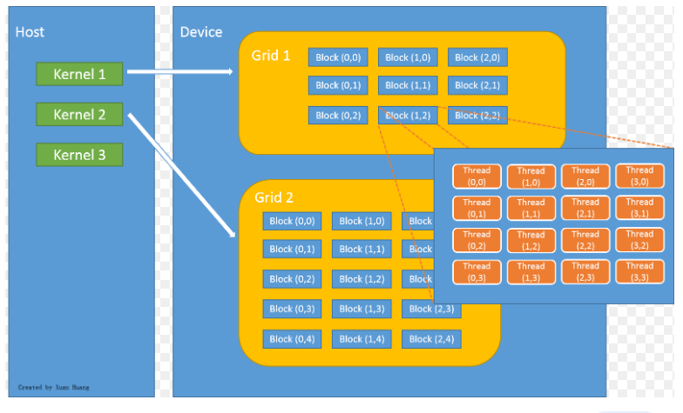


CUDA execution Units

Slide 68
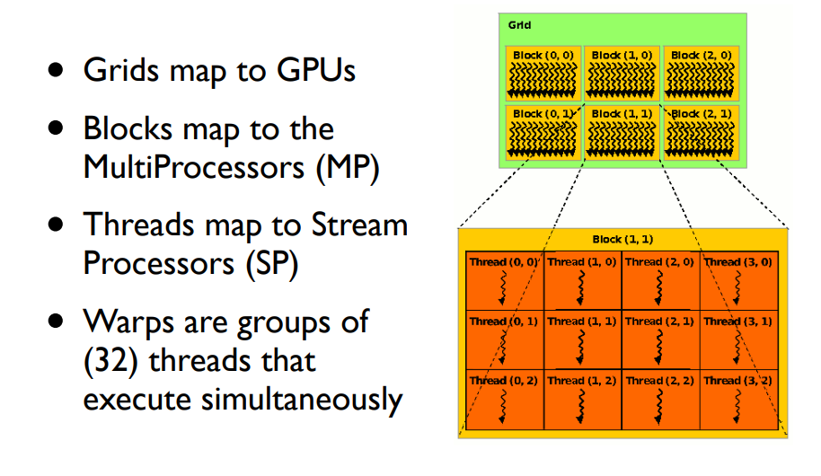
CUDA execution Units

Slide 69
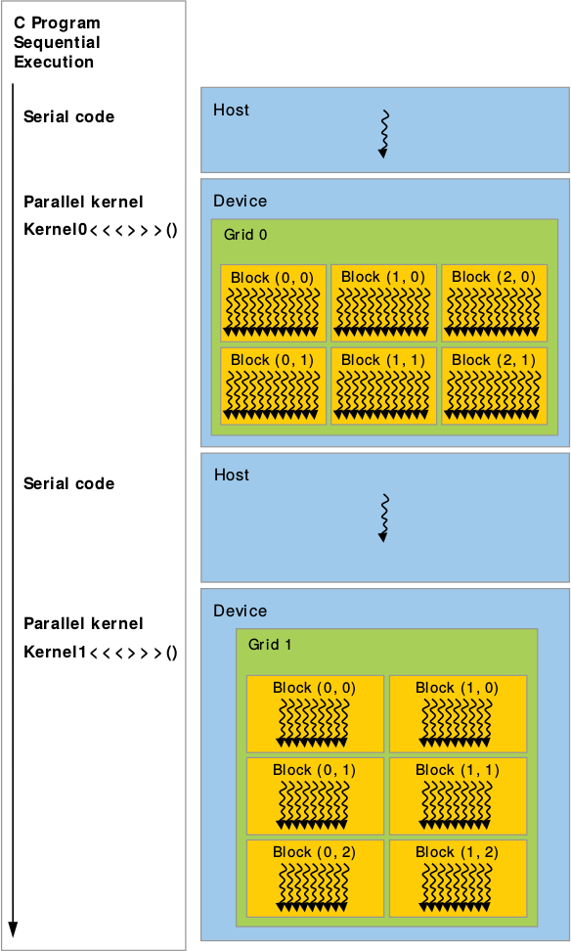
Structure of a CUDA Code
Source: CUDA C Programming Guide
(NVIDIA)

Slide 70
Vector addition (old method)
int m[200], n[200], p[200],*md, *nd,*pd;
int size = 200 * sizeof(int);
// Initialize array m and array n
...
cudaMalloc(&md, size);
cudaMemcpy(md, m, size, cudaMemcpyHostToDevice);
cudaMalloc(&nd, size);
cudaMemcpy(nd, n, size, cudaMemcpyHostToDevice);
cudaMalloc(&pd, size);
arradd<<< 1,200 >>>(md,nd,pd);
cudaMemcpy(p, pd, size, cudaMemcpyDeviceToHost);
cudaFree(md);
cudaFree(nd);
cudaFree(pd);

Slide 71
“Kernel” function
global void arradd(int* md, int* nd, int* pd)
{
int myid = threadIdx.x;
pd[myid] = md[myid] + nd[myid];
}

Slide 72
Defining Grid/Block Structure
Need to provide each kernel call with values for two key structures:
• Number of blocks in each dimension
• Threads per block in each dimension
• myKernel<<< B, T >>>(arg1, … );
• B – a structure that defines the number of blocks in grid in each dimension (1D or 2D).
• T – a structure that defines the number of threads in a block in each dimension (1D, 2D, or 3D).

Slide 73
1D Grids and/or 1D Blocks
•
•
•
•
If want a 1-D structure, can use a integer for B and T in:
myKernel<<< B, T >>>(arg1, … );
B – An integer would define a 1D grid of that size T – An integer would define a 1D block of that size
•
Example: myKernel<<< 1, 100 >>>(arg1, ... );

Slide 74
CUDA Built-In Variables
blockIdx.x, blockIdx.y, blockIdx.z are built-in variables that returns the block ID in the x-axis, y-axis, and z-axis of the block that is executing the given block of code.
threadIdx.x, threadIdx.y, threadIdx.z are built-in variables that return the thread ID in the x-axis, y-axis, and z-axis of the thread that is being executed by this stream processor in this particular block.
blockDim.x, blockDim.y, blockDim.z are built-in variables that return the “block dimension” (i.e., the number of threads in a block in the x-axis, y-axis, and z-axis).
So, you can express your collection of blocks, and your collection of threads within a block, as a 1D array, a 2D array or a 3D array.
These can be helpful when thinking of your data as 2D or 3D.
The full global thread ID in x dimension can be computed by:
•
x = blockIdx.x * blockDim.x + threadIdx.x;

Slide 75
Thread Identification Example: x-direction
Global Thread ID
0 | 1 | 2 | 3 | 4 | 5 | 6 | 7 | 8 | 9 | 10 | 11 | 12 | 13 | 14 | 15 | 16 | 17 | 18 | 19 | 20 | 21 | 22 | 23 | 24 | 25
26
27 | 28 | 29 | 30 | 31
threadIdx.x
threadIdx.x
threadIdx.x
threadIdx.x
0 | 1 | 2 | 3 | 4 | 5 | 6 | 7 | 0 | 1 | 2 | 3 | 4 | 5 | 6 | 7 | 0 | 1 | 2 | 3 | 4 | 5 | 6 | 7 | 0 | 1 2 3 | 4 | 5 | 6 | 7
blockIdx.x = 0 |  |  |  |  |  |  |  | blockIdx.x = 1 |  |  |  |  |  |  |  | blockIdx.x = 2 |  |  |  |  |  |  |  | blockIdx.x = 3
•
Assume a hypothetical 1D grid and 1D block architecture: 4 blocks, each with 8 threads.
•
For Global Thread ID 26:
gridDim.x = 4 x 1
blockDim.x = 8 x 1
Global Thread ID = blockIdx.x * blockDim.x + threadIdx.x
= 3 x 8 + 2 = 26
•
•
•
•

Slide 76
GPU Memories
1. Global Memory : Global memory can be considered the main memory space of the GPU in CUDA. It is allocated, and managed, by the host, and it is accessible to both the host and the GPU, and for this reason the global memory space can be used to exchange data between the two.
2. Shared Memory: Shared memory is a CUDA memory space that is shared by all threads in a thread block. In this case shared means that all threads in a thread block can write and read to block-allocated shared memory, and all changes to this memory will be eventually available to all threads in the block.
3. Constant Memory: It is used for storing data that will not change over the course of kernel execution. It supports short-latency, high-bandwidth, read-only access by the device when all threads simultaneously access the same location. There is a total of 64K constant memory on a CUDA capable device. The constant memory is cached.

